Slide 1
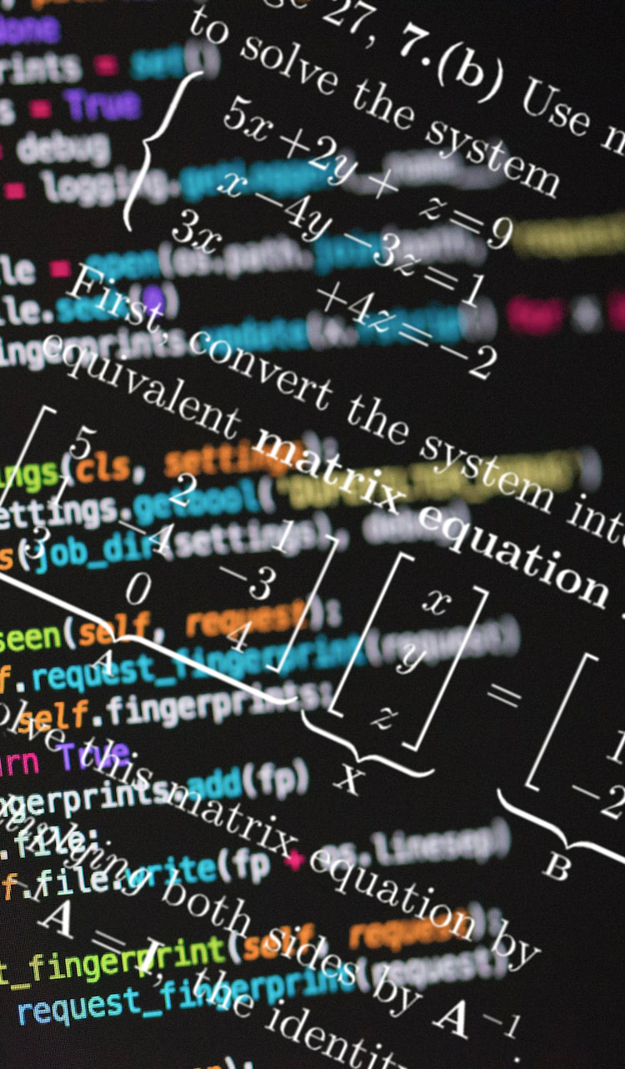
Documentation and Handling Errors
Data Sciences Institute
University of Toronto
Simeon Wong
Notes:
Hi everyone, welcome back to our 3rd week of Data Science Fundamentals

Slide 2
Previously at the DSI…
Configuring programs
Configuration files make your use of programs documented and repeatable
Writing configuration files in YAML
Loading YAML configuration files into Python
Application Programming Interfaces
Programs using programs
REST is the quasi-standard for Web APIs
Using Python requests to retrieve data from GitHub programmatically

Slide 3
Course overview
Configuration files & Environment variables
Using and writing Application Programming Interfaces (APIs)
Handling errors
Testing software
Building Python packages
Working in software teams using GitHub features

Slide 4
Daily scrum
Write in the chat:
How you’ll use one thing you’ve learned so far
One thing you’re struggling with / wish the course addressed

Slide 5
Asking questions
Zoom chat during class
Feel free to post and answer questions at any time
I will pause for questions occasionally, and review questions from the chat
Pre- / Post-class office hours with Tong
Email
simeonm.wong@mail.utoronto.ca
tong.su@mail.utoronto.ca

Slide 6
Assessments
Outcomes-based learning
> 75% of course outcomes
Assessed with both in-class exercises and summative project
Summative project:
The next 4 classes build on each other
We will work on the summative project step-by-step through each class

Slide 7
Carpentry analogy
“These are the tools (e.g. hammer / drill) and this is how to hold it, turn it on, hammer a nail, drill a hole with it”
Shell: interacting with computers via text; computer fundamentals
Intro to Python: computer science and programming fundamentals
“Now let’s build a simple chair… and a simple table…”
Building Software: programming in teams, testing and deploying code, interacting with data sources
Notes:
You might not need to build chairs and tables in your everyday work, but maybe you’ll build something that looks like it.
Examples of how to put pieces together, so you can do the same in your own contexts.

Slide 8
APIs revisited
An interface designed for programs to use your code / system (as opposed to interfaces designed primarily for humans)
Documentation on how to use it
Physical analogy:
Adding a button to your device
Writing instructions: how to push the button and what pushing the button does

Slide 9
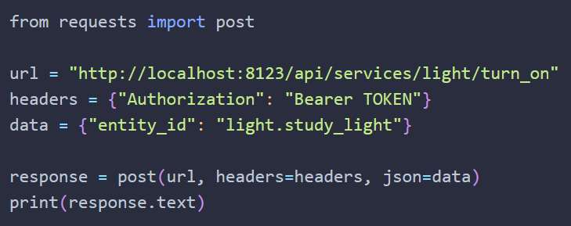
APIs revisited
Allows you to build better systems by using other people’s code / services / technology
E.g. Building a house… you can buy a lightbulb instead of making one yourself
Allows your code to interact (use data from, or perform actions) outside of your computer

Slide 10
Today’s learning outcomes
Given a function, I can write API documentation
Given documentation, I can write Python class and function headers described by that documentation
I can interpret a Python error message
I can catch and handle errors using try/except
I can write helpful error messages
I can use the Python logging library to control output from my code

Slide 11
Why documentation?
Documentation
“Code is more often read than written.”
— Guido van Rossum
Code is read by yourself (in the future) and by other developers who use it or contribute to it
Code that cannot be properly understood …
e.g. its required inputs, its methods, and its outputs
… can be used in situations or in ways that result in errors or mistakes

Slide 12
Commenting vs Documenting code
Documentation
Comments describe your code for other developers
It makes it easier to understand how (algorithmically) and why
Helps with understanding intention, purpose, and design rationale
Documentation describes your code for your users
What your code does (for a user) and how to use it
Both are important!

Slide 13
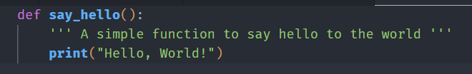
Python docstrings
Documentation
Official Python standard to describe your code’s functionality
Wrapped in ‘’’triple apostrophes or quotation marks’’’ at the very beginning of a function
Reference: https://peps.python.org/pep-0257/

Slide 14
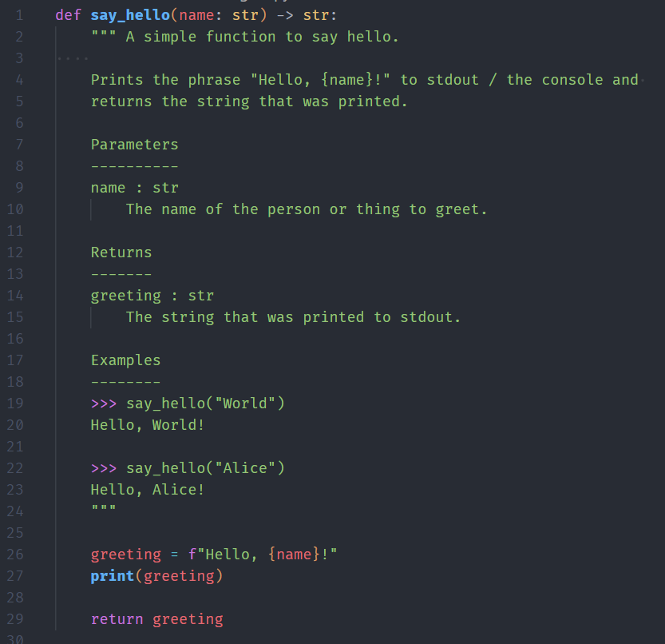
The numpy docstring style
Documentation
Short summary (max one-line)
Extended summary / description of function
List of parameters formatted as:
param_name : param_type
Description of parameter
List of returned values formatted as:
value_type
Description of this value
Optional examples
Reference: https://numpydoc.readthedocs.io/en/latest/format.html
Notes:
A commonly-used extension to the Python docstring with details on what to include and how to format it

Slide 15
Python type hints
Documentation
The Python standard for documenting the types of values expected by your function
Concise way of representing a subset of the information from the numpy docstring
Function returns a str
name should be a str
References: https://peps.python.org/pep-0484/

Slide 16
$> Interactive live coding
Documentation
Refactor the Hello World program as a function
Rewrite the command-line arguments as function parameters
Use Python type hints
Write a docstring for the function
Call the Hello World function based on the parsed arguments

Slide 17
Sphinx documentation generator
Documentation
The most common web-based / online documentation generator for Python projects
Parses your docstrings and other indicated text files
Compiles into HTML files
Easier to read and browse
Easier to share online (or on an internal site) with your users
Requires a moderate amount of setup to get started
Example at https://github.com/dtxe/UTDSI_202401_building_software/tree/main/lessons/2%20-%20Documentation%20and%20errors/sphinx-example

Slide 18
$> Interactive live coding
Documentation
Install sphinx, numpydoc, and myst-parser (markdown parser)
Copy and paste sphinx configuration and index files
Generate documentation for your GitHub file

Slide 19
Exercise: Refactor your GitHub API code
Documentation
Which function parameters are needed?
Write a docstring for the function in the numpy style

Slide 20
What questions do we have?

Slide 21
Course overview
Configuration files & Environment variables
Using and writing Application Programming Interfaces (APIs)
Handling errors
Testing software
Building Python packages
Working in software teams using GitHub features

Slide 22
Errors in Python
Handling errors
Two main types of errors in Python:
Syntax Error: code that is not understandable (e.g. not valid Python statements)
Exceptions: code that is syntactically correct, but cannot be executed
When Python executes code that results in an error, it raises an Exception
If not handled, exceptions will cause Python to stop executing your code and quit
In Python notebooks like colab, it will stop executing code, but it won’t close your notebook

Slide 23
Why errors occur
Handling errors
Syntax Errors: usually easy-to-fix issue with the code
Exceptions:
Can be a coding error or an error external to the program (e.g. network issues)
Usually caused by a combination of / an interaction between the code and some external factors
e.g. The file specified by the user doesn’t exist, but your program wasn’t coded to check first

Slide 24
The Exception object
Handling errors
Contains information about the nature of the Exception
e.g. ValueError, NameError, TypeError, ZeroDivisionError
Contains the line of code that caused the error
Contains the context where the exception was raised
Also called the stack traceback
List of function calls that led to the current error
This info is useful to a programmer, but maybe not to a user
Recall: user more about how to use it rather than how it works inside

Slide 25
try/except
Handling errors
Allows your code to handle an error without stopping code execution
Some possibilities:
Raise a modified Exception with more helpful error messages
Recall: Error info is useful to a programmer, but maybe not to a user
Diagnose and try to fix the error
Cannot reach primary API server, let’s try the secondary one
Ignore/log the error and move on
Processing a batch of files in a loop: move onto the next file and alert the user at the end which files didn’t work
Be careful of failing silently: undetected errors are problematic

Slide 26
$> Interactive live coding
Handling errors
Handle a ValueError when converting str to int
Add a note using e.add_note()
Handle a ConnectionError from the requests library
Refer to requests documentation about types of Exceptions raised
Try to connect to a backup API

Slide 27
What questions do we have?

Slide 28
Defensive programming
Handling errors
Mistakes will happen. Guard against mistakes.
Your code can raise errors when it detects a problem.
We can add user-defined error messages to indicate the error.

Slide 29
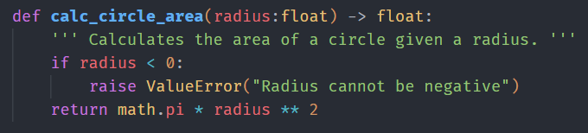
Writing your own exceptions
Handling errors
Use the raise keyword along with an Exception object

Slide 30
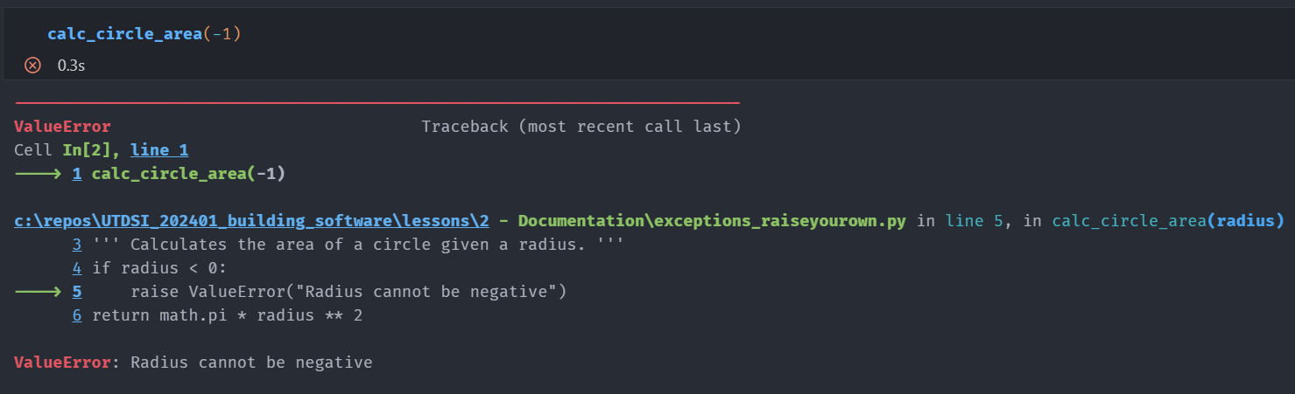
Writing your own exceptions
Handling errors

Slide 31
Writing useful error messages
Handling errors
Be specific, clear, concise, and actionable
Not specific: “Error”
Better, but still not specific: “ValueError”
Great: “ValueError: got 52.1 (float) but expected an integer”
Write for your audience’s level of understanding.
“Authorization error: credentials have expired” vs. “HTTPError_401”
Use consistent vocabulary within projects and organizations
Is a “Loading Error” the same as a “File not found” error?

Slide 32
Writing useful error messages
Handling errors
Don’t blame the user
“OSError: data.txt not found” is better than “UserError: Your path is wrong”
Avoid catastrophe words
“fatal”, “illegal”, “danger”, “aborted” may make users worry unnecessarily about device or data damage
Avoid jokes and cutesy language
Don’t do this: “Oopsie-daisy! Looks like the value you provided wasn’t an integer! Why don’t you try again pal!”

Slide 33
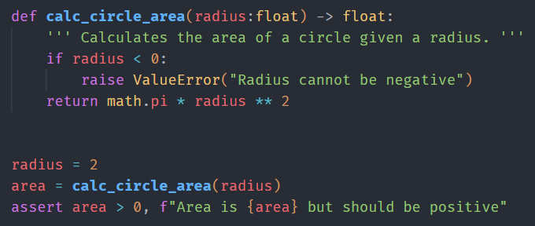
Assertions
Handling errors
Short-hand way of raising an error if a statement is false
Useful for checking the consistency of your program state
guard against programming error
a form of documenting your code and thought process
Use for conditions that should never be true (invariant)
If this is false, something is very wrong in our code!

Slide 34
When to raise vs assert
Handling errors
raise
Use for most things (e.g. input validation, failed operations)
Exception types (ValueError, etc.) provide detailed information
assert
Use to detect invariants – things that should never happen
Always raises an AssertionError with an optional message
Helps catch coding mistakes and annotate programmer’s inner mindset

Slide 35
What questions do we have?

Slide 36
The Python logging library
Handling errors
Not all detectable issues are full-blown errors
Python’s logging library allows for more nuanced messages of different severity levels
DEBUG: very detailed information used to diagnose outputs
INFO: confirmation messages
WARNING: possible unexpected result or scenario, but code can continue
ERROR: the program cannot continue, but no “permanent damage”
CRITICAL: potential loss of data, security issues

Slide 37
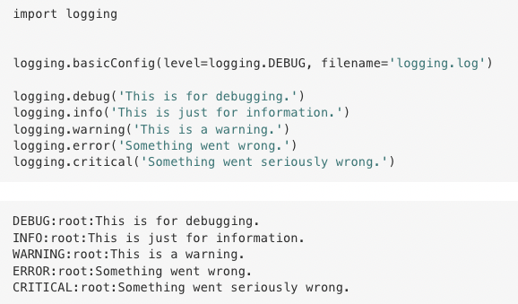
The Python logging library
Handling errors
Allows the user to specify which level of messages they want to see at any given time
Logging levels always include messages of higher severity

Slide 38
$> Interactive live coding
Handling errors
Demonstrate the logging library

Slide 39
What questions do we have?

Slide 40
Today’s learning outcomes
Given a function, I can write API documentation
Given documentation, I can write Python class and function headers described by that documentation
I can interpret a Python error message
I can catch and handle errors using try/except
I can write helpful error messages
I can use the Python logging library to control output from my code

Slide 41
Exercise + Homework
Add error handling and logging to your GitHub API code from lesson 1
Write useful error messages
Use try/catch
Validate inputs
Consider where DEBUG, INFO, and WARNING messages might be useful
Commit and push your changes to the same repository from Lesson 1
If you haven’t already, submit here: https://uoft.me/dsi-1-bs-a1

Slide 42
References
Research Software Engineering with Python by Damien Irving, Kate Hertweck, Luke Johnston, Joel Ostblom, Charlotte Wickham, and Greg Wilson (https://merely-useful.tech/py-rse/config.html)
PEP 257 (python.org)
Style guide — numpydoc v1.7.0rc0.dev0 Manual

